Slide 1
EECS498-008 Formal Verification of Systems Software
Material and slides created by
Jon Howell and Manos Kapritsos

Slide 2
Dafny Modules
Namespace scoping
Parameterization
Automation control

Slide 3
Dafny Modules: namespace scoping
import
module Network { … }
module Host { … }
module DistributedSystem {
import Host;
datatype Variables = Variables(host:Host.Variables, network:Net.Variables)
predicate Next(v:Variables, v’:Variables) {
Host.Next(v.host, v’.host) } }

Slide 4
Dafny Modules: Parameterization
abstract module
network.t.dfy
network.t.dfy
protocol.v.dfy
dist_system.t.dfy
protocol.v.dfy
dist_system.t.dfy
instantiated.v.dfy
proof.i.dfy
proof.v.dfy

Slide 5
Dafny Modules: Automation Control
export
Control visibility into function & predicate bodies.
Transparent on the inside, opaque from the outside.

Slide 6
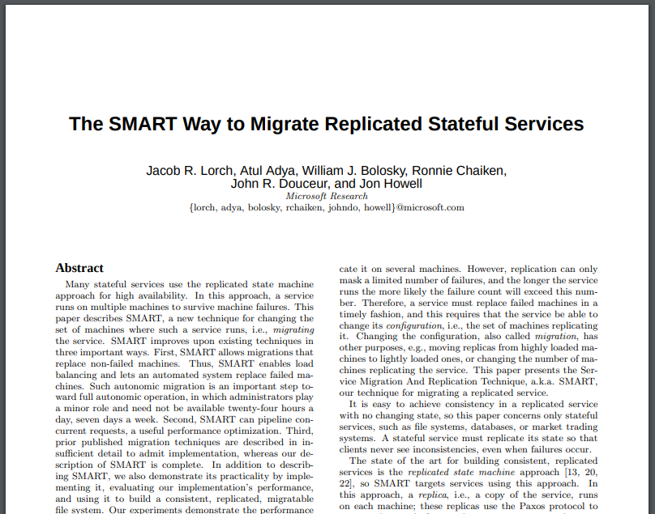
Automation

Slide 7
Automation
The power of automation is to wipe out tedious tasks
When it stops short, you have to add an "observe"
When it goes too far, the verifier times out

Slide 8
Automation
function double(x:int) : int { 2*x }
forall x :: double(x) == 2*x
assert double(4) == 8
double(4) != 8
double(4) == 2*4
8 != 2*4
false

Slide 9
Automation
function dbl(x:nat) {
if x==0 then 0 else dbl(x-1)+2
}
∀ x :: dbl(x) ==
if x==0 then 0 else dbl(x-1)+2
assert dbl(4) == 8
dbl(4) != 8
if 4==0 then 0 else dbl(4-1)+2 != 8
if 4==0 then 0 else if 4-1==0 then 0 else dbl(4-1-1)+2+2 != 8
if 4==0 then 0 else if 4-1==0 then 0 else if 4-1-1==0 then 0 else dbl(4-1-1-1)+2+2+2 != 8

Slide 10

The Timeout Monster rears its head only when you’re trying to prove false things…
...which is basically all the time.
image: pixabay

Slide 11
Now imagine you have a tall tree of definitions
data structures
functions to manipulate them
set and map comprehensions
predicates to define transitions
...all of which are creating implicit forall quantifications!

Slide 12

The landscape of heuristic automation
we want to open most definitions a few times, but
we never want an infinitely-reachable space.
we can afford a pretty big space, but
we eventually have to curtail even the finite space
image: Remy Charlip, fair use

Slide 13

We add automation to cover more ground
We remove automation when it gets us in trouble
The result is a convoluted manifold… and we always want to be right on its edge!
What do we do when we slip off the edge?
image: pxfuel.com

Slide 14
Four-Step Timeout Cure
Detection
Diagnosis
Correction
Proof Repair

Slide 15
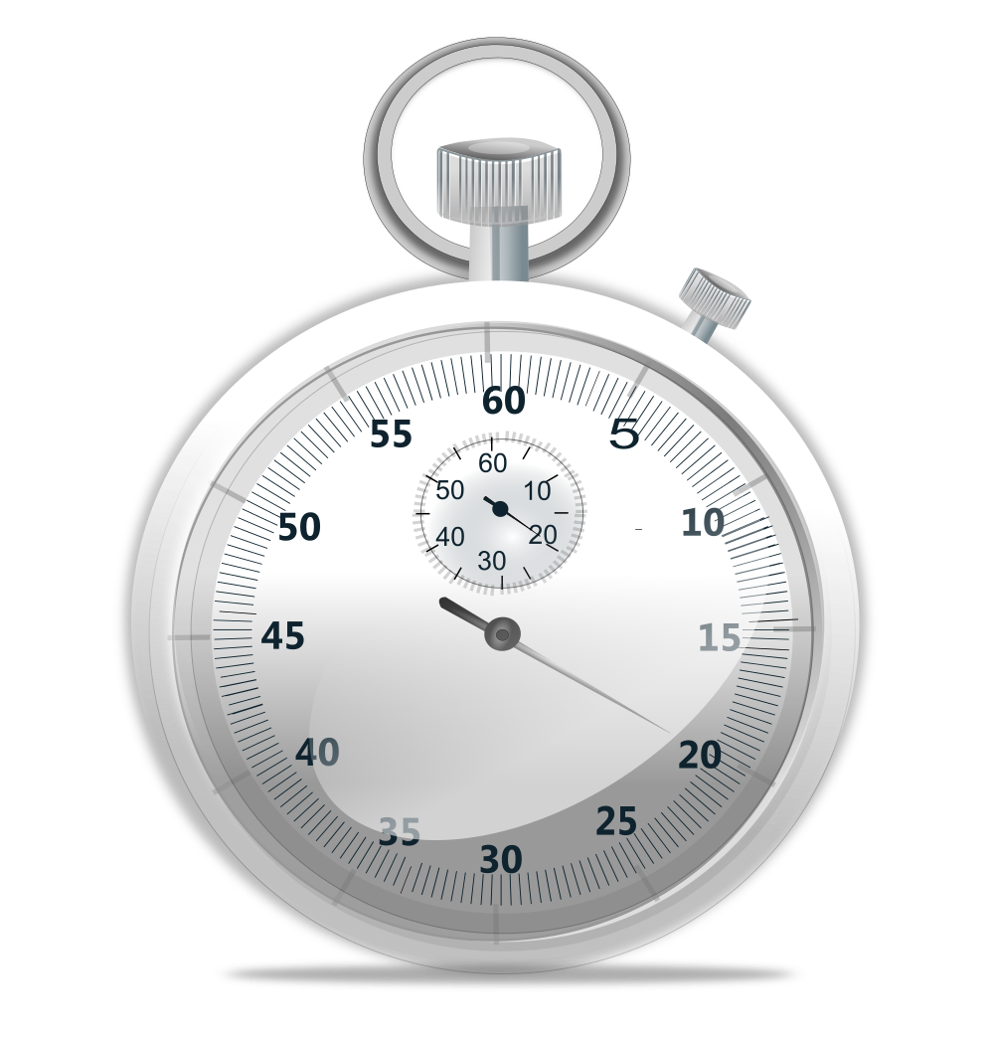
Detection
time dafny
dafny /timeLimit:20
dafny /trace
time dafny /proc:"*Pattern"
You need this wildcard because you're actually matching a mangled Boogie name.
image: freesvg.org

Slide 16
Diagnosis
dafny /timeLimit:10 /trace chapter10/demos/exercise01_solution_with_timeouts.dfy
dafny-profile.py 10 "*SendShardKeepsMapsFull" chapter10/demos/exercise01_solution_with_timeouts.dfy

Slide 17
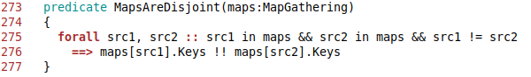
Dafny program verifier finished with 0 verified, 0 errors, 1 time out
max
67000 exercise01solutionwithtimeoutsdfy.275:12
3000 funType:MapType0Select
2000 cast:U_2_bool
1000 DafnyPreludebpl.141:18
1000 exercise01solutionwithtimeoutsdfy.270:12
1000 funType:$Unbox
Don't chase phantoms.
Only worry about the worst one, then profile again.

Slide 18
Syntactic Triggers
print-triggers chapter10/demos/exercise01_with_timeouts.dfy > triggers
exercise01_with_timeouts.dfy(275,4): Info: Selected triggers:
{maps[src2], maps[src1]}, {maps[src2], src1 in maps}, {maps[src1], src2 in maps}, {src2 in maps, src1 in maps}

Slide 19
Correction
Hiding Technique
∀ x :: layer(x) == layer(x+1) - 1
→ ∀ x :: layer(x) == LayerRelation(x)
function {:opaque} Foo()
hide an ∃ or map/set comprehension
controlled module export
Exposing Technique assert LayerRelation(y);
reveal_Foo()
export the forall part (+rarely mention or reveal_)
good export design

Slide 20
Proof Repair
Run a full verification to see which proofs failed
New failures are usually easy to fix: apply the exposing technique!

Slide 21
What about funType?
"nearby" instantiations may point at a map comprehension
use {:opaque} to see if you can replace the timeout with a fast failure (don't bother repairing the proof until you're certain you understand the cause)

Slide 22
Four-Step Timeout Cure
Detection: fix timeouts right away!
Diagnosis: quantifier-instantiation profiler
Correction: hide definitions
Proof Repair: fix right after timeout correction

